Slide 1
What is Statistical Learning?
Chapter 02 – Part I

Slide 2
Vocabulary
Matrix | 矩阵 | Vector | 向量 | Element | 元素
Variable | 变量 | First-Order Derivative | 一阶导数 | Partial Derivative | 偏导数
Linear | 线性的 | nonlinear | 非线性的 | Mean | 均值
Expectation | 期望值 | Median | 中值 | Variance | 方差
Standard Deviation | 标准差 | Regression | 回归 | Classification | 分类
Clustering | 聚类 | Taylor series | 泰勒级数 | Differential equation | 微分方程
Partial Differential Equation | 偏微分方程 | w.r.t. with respect to | …关于…的 | Norm | 模，范数
Trace | 迹 | Normal distribution | 正态分布 | Uniform distribution | 平均分布
Arithmetic progression | 等差数列 | Fit | 拟合 | Dimension | 维度
Coordinate | 坐标 | Coordinate system | 坐标系 | Axis | 坐标轴
Label | 标记 | Argument | （函数）自变量 | Parameter | 参数
Supervised | 有监督的 | Unsupervised | 无监督的 | Semi-supervised | 半监督的
Tradeoff | 折中 | Scalar | 标量 | Polynomial | 多项式

Slide 3
Outline
What Is Statistical Learning?
Why estimate f?
How do we estimate f?
The trade-off between prediction accuracy and model interpretability
Supervised vs. unsupervised learning
Regression vs. classification problems

Slide 4
What is Statistical Learning?
Suppose we observe and for
We believe that there is a relationship between Y and at least one of the X’s.
We can model the relationship as
Where f is an unknown function and ε is a random error with mean zero.

Slide 5
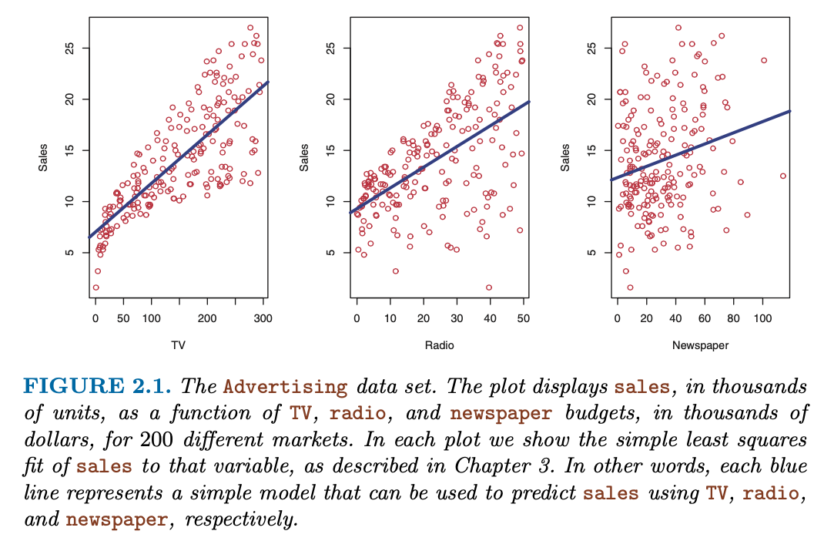
A Simple Linear Model

Slide 6
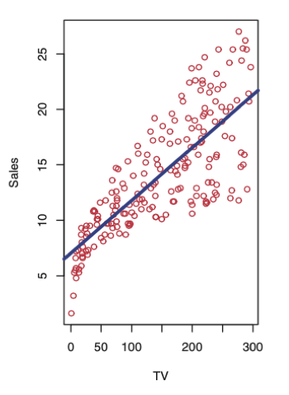

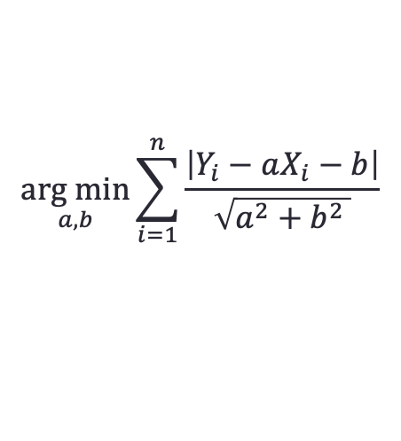


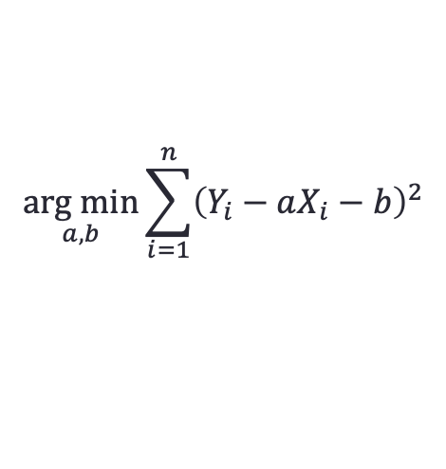
A Simple Linear Model
$$Y=aX+b+ε$$
$$\underset{a,b}{arg min}{\sum_{i=1}^{n}{{\left(Y_{i}−aX_{i}−b\right)}^{2}}}$$
$$\min_{x}{{(x−1)}^{2}⟹}{0}$$
$$\underset{x}{arg min}{{(x−1)}^{2}⟹1}$$
$$\underset{a,b}{arg min}{\sum_{i=1}^{n}{\frac{\left|Y_{i}−aX_{i}−b\right|}{\sqrt{a^{2}+b^{2} }}}}$$
Only feasible for linear models
Difficult to calculate
Few accuracy gain

Slide 7
A Simple Nonlinear Model

Slide 8


A Simple Nonlinear Model
ε_{i}
$$Y=a{\left(X−b\right)}^{3}+c+ε$$
$$\underset{a,b,c}{arg min}{{\left(Y_{i}−a{\left(X_{i}−b\right)}^{3}−c\right)}^{2}}$$
f

Slide 9
Different Standard Deviations
The difficulty of estimating f will depend on the standard deviation of the ε’s.

Slide 10
Different Estimates For f

Slide 11
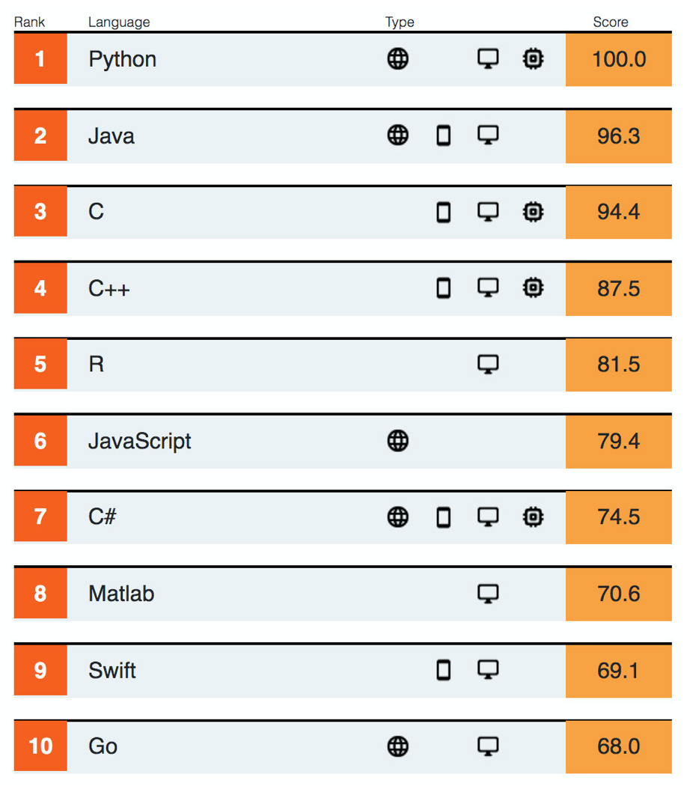
Introduction to R
R is an open-source, free and light computation software widely-used in statistics, economy, information technology, etc. It’s easy to transfer your R programming skill to other computation programming language, such as MATLAB.
MATLAB occupies more than 10 GB disk space and it is a commercial software.
Why not python?
Python is widely-used in deep learning area. However, it is an object-oriented language. It is difficult to learn in a short time for students without any knowledge about object-oriented programming language.
Our course focuses on the fundamental knowledge of statistical learning. It’s better not to take too much time on learning a new programming language. You will find R is as easy as a sophisticated calculator.
Source: IEEE Spectrum

Slide 12
Which Language(s) Should I Learn?
Java
Web Developer
Desktop Developer
Objective-C
Apple
Qt
JavaScript
Microsoft
Swift
Android
Mobile Developer
iOS
Scientific Researcher
PHP
Go
Deep Learning
1
2
Python
3
MATLAB
Game Developer
Low-level Development
Unity
C#
Unreal Engine
R
1. Digital Signal Processing, Communication, FPGA… (where license is not a problem)
Delphi
C/C++
2. Finance, Economics, Statistics… (where license matters)
3. Physics, Distributed Computation, Computer Graphics…

Slide 13
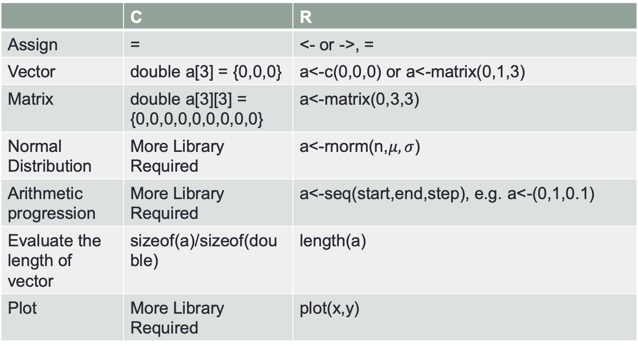
Introduction to R
 | C | R
Assign | = | <- or ->, =
Vector | double a[3] = {0,0,0} | a<-c(0,0,0) or a<-matrix(0,1,3)
Matrix | double a[3][3] = {0,0,0,0,0,0,0,0,0} | a<-matrix(0,3,3)
Normal Distribution | More Library Required | a<-rnorm(n,$μ,σ$)
Arithmetic progression | More Library Required | a<-seq(start,end,step), e.g. a<-(0,1,0.1)
Evaluate the length of vector | sizeof(a)/sizeof(double) | length(a)
Plot | More Library Required | plot(x,y)

Slide 14
Introduction to R
Generate variable vector
seq(start,end,step)
Generate function value vector
Add noise
rnorm(n,mean,sd)
plot
plot(x,y,xlab=‘’,ylab=‘’,main=‘’,type=’l’,pch=‘*’,col=‘green’,axes=TRUE)
lines(x,y) or points(x,y) # continue plot lines or points on the orignial figure

Slide 15


Exercises
1. Plot the figure of the following function in $\left[0,2π\right].$
$$y=sin⁡(x^{2})$$
2. Simulate the following figure
$$z=x^{\frac{13}{24}}+N\left(0,0.2\right)x^{\frac{13}{24}}$$

Slide 16
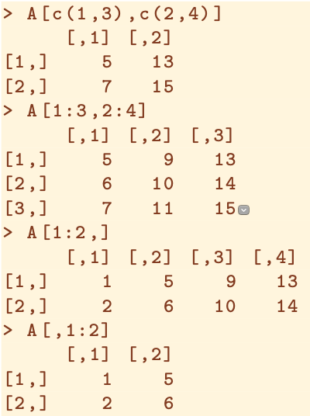
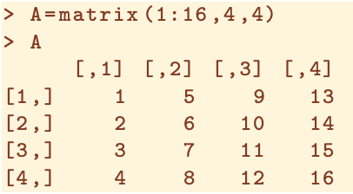




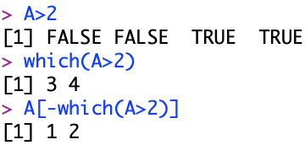
Indexing data
Delete elements from a vector

Slide 17

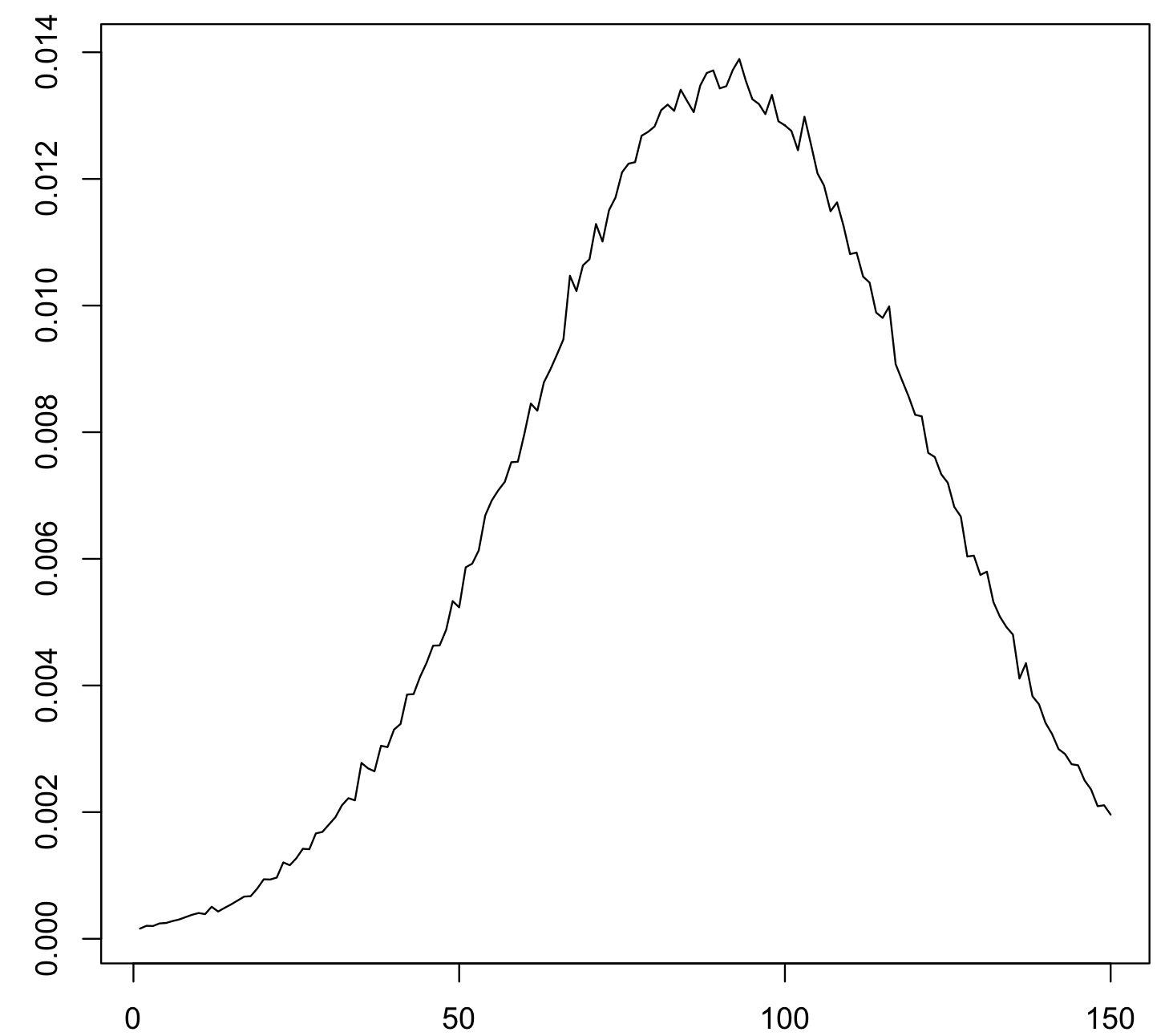

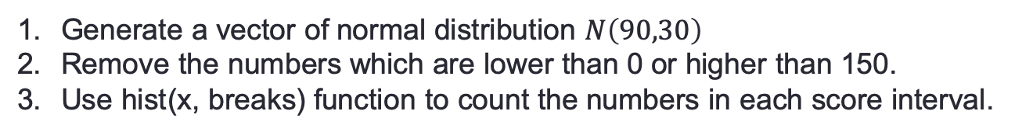
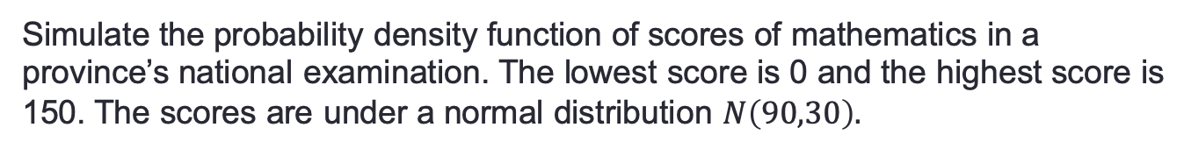
Example
Simulate the probability density function of scores of mathematics in a province’s national examination. The lowest score is 0 and the highest score is 150. The scores are under a normal distribution $N\left(90,30\right).$
Generate a vector of normal distribution $N\left(90,30\right)$
Remove the numbers which are lower than 0 or higher than 150.
Use hist(x, breaks) function to count the numbers in each score interval.

Slide 18
Why Do We Estimate f?
There are 2 reasons for estimating f,
Prediction and
Inference.

Slide 19
1. Prediction
If we can produce a good estimate for f (and the variance of ε is not too large) we can make accurate predictions for the response, Y, based on a new value of X.

Slide 20
Example: Direct Mailing Prediction
Interested in predicting how much money an individual will donate based on observations from 90,000 people on which we have recorded over 400 different characteristics.
Don’t care too much about each individual characteristic.
Just want to know: For a given individual should I send out a mailing?

Slide 21
2. Inference
Alternatively, we may also be interested in the type of relationship between Y and the X's.
For example,
Which particular predictors actually affect the response?
Is the relationship positive or negative?
Is the relationship a simple linear one or is it more complicated etc.?

Slide 22
Example: Housing Inference
Wish to predict median house price based on 14 variables.
Probably want to understand which factors have the biggest effect on the response and how big the effect is.
For example how much impact does a river view have on the house value etc.

Slide 23
How Do We Estimate f?
We will assume we have observed a set of training data
We must then use the training data and a statistical method to estimate f.
Statistical Learning Methods:
Parametric Methods
Non-parametric Methods

Slide 24
Parametric Methods
It reduces the problem of estimating f down to one of estimating a set of parameters.
They involve a two-step model based approach
STEP 1:
Make some assumption about the functional form of f, i.e. come up with a model. The most common example is a linear model i.e.
However, in this course we will examine far more complicated, and flexible, models for f. In a sense the more flexible the model the more realistic it is.

Slide 25
Parametric Methods (cont.)
STEP 2:
Use the training data to fit the model i.e. estimate f or equivalently the unknown parameters such as β₀, β₁, β₂,…, β_{p}.
The most common approach for estimating the parameters in a linear model is ordinary least squares (OLS).
We will see in the course that there are often superior approaches.

Slide 26
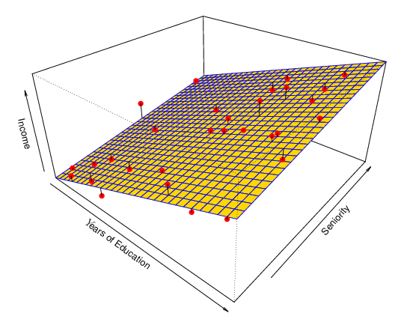
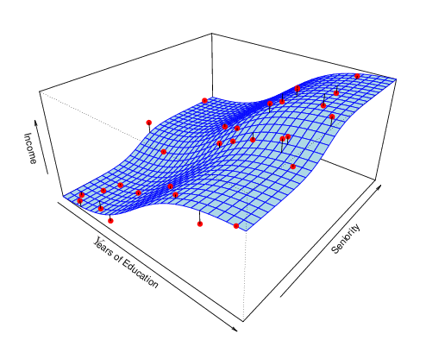
Example: A Linear Regression Estimate
Even if the standard deviation is low we will still get a bad answer if we use the wrong model.

Slide 27
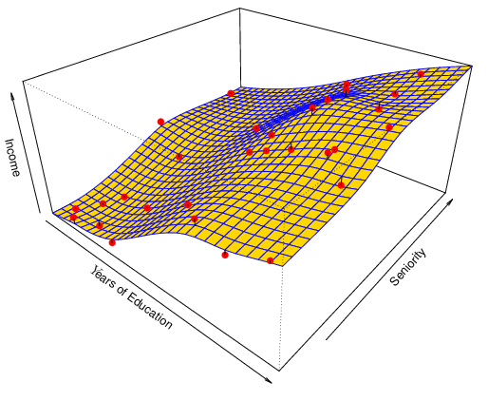
Example: A Thin-Plate Spline Estimate
Non-linear regression methods are more flexible and can potentially provide more accurate estimates.

Slide 28
Non-parametric Methods
They do not make explicit assumptions about the functional form of f.
Advantages: They accurately fit a wider range of possible shapes of f.
Disadvantages: A very large number of observations is required to obtain an accurate estimate of f
1.2
2.2
3.2
1.2
2.2
3.2
f(2.5)=?

Slide 29
Tradeoff Between Prediction Accuracy and Model Interpretability
Why not just use a more flexible method if it is more realistic?
There are two reasons
Reason 1:
A simple method such as linear regression produces a model which is much easier to interpret (the Inference part is better). For example, in a linear model, β_{j} is the average increase in Y for a one unit increase in X_{j} holding all other variables constant.

Slide 30
Reason 2:
Even if you are only interested in prediction, so the first reason is not relevant, it is often possible to get more accurate predictions with a simple, instead of a complicated, model. This seems counter intuitive but has to do with the fact that it is harder to fit a more flexible model.

Slide 31
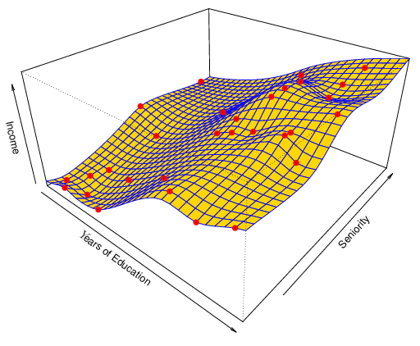
A Poor Estimate
Non-linear regression methods can also be too flexible and produce poor estimates for f.

Slide 32
Overfitting vs Underfitting

Slide 33
Supervised vs. Unsupervised Learning
Supervised Learning:
Supervised Learning is where both the predictors, X_{i}, and the response, Y_{i}, are observed.
This is the situation you deal with in Linear Regression classes.
Most of this course will also deal with supervised learning.

Slide 34
Unsupervised Learning:
In this situation only the X_{i}’s are observed.
We need to use the X_{i}’s to guess what Y would have been and build a model from there.
A common example is market segmentation where we try to divide potential customers into groups based on their characteristics.
A common approach is clustering.
We will consider unsupervised learning at the end of this course.

Slide 35
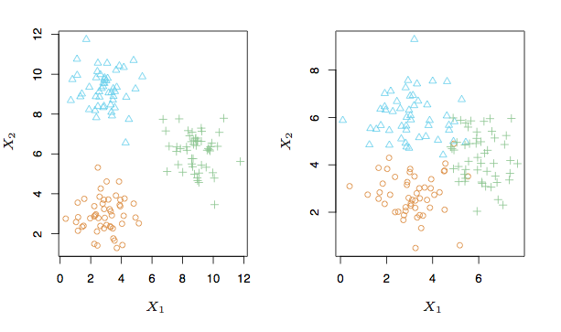
A Simple Clustering Example

Slide 36
Regression vs. Classification
Supervised learning problems can be further divided into regression and classification problems.
Regression covers situations where Y is continuous/numerical. e.g.
Predicting the value of the Dow in 6 months.
Predicting the price of a given house based on various inputs.
Classification covers situations where Y is categorical e.g.
Will the Dow be up (U) or down (D) in 6 months?
Is this email a SPAM or not?

Slide 37
Different Approaches
We will deal with both types of problems in this course.
Some methods work well on both types of problem e.g. Neural Networks
Other methods work best on Regression, e.g. Linear Regression, or on Classification, e.g. k-Nearest Neighbors.

Slide 38
Summary
Plot and generate normally distributed data in R
The difference between inference and prediction
Parametric methods and non-parametric methods
Tradeoff between prediction accuracy and interpretability.
Overfitting and underfitting
Supervised and unsupervised learning
Regression and classification

Slide 39
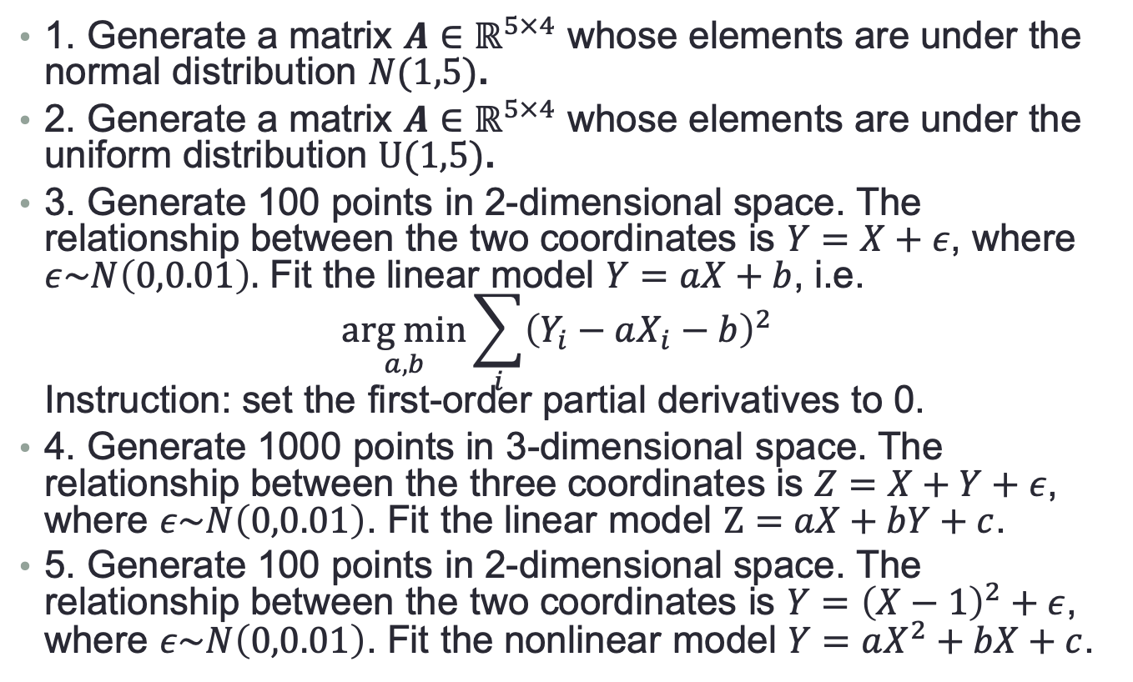
More Exercises for R
1. Generate a matrix $A∈ℝ^{5×4}$ whose elements are under the normal distribution $N(1,5)$.
2. Generate a matrix $A∈ℝ^{5×4}$ whose elements are under the uniform distribution $U(1,5)$.
3. Generate 100 points in 2-dimensional space. The relationship between the two coordinates is $Y=X+ε$, where $ε\sim N\left(0,0.01\right).$ Fit the linear model $Y=aX+b$, i.e. $\underset{a,b}{arg min}{\sum_{i}{{\left(Y_{i}−aX_{i}−b\right)}^{2}}}$ Instruction: set the first-order partial derivatives to 0.
4. Generate 1000 points in 3-dimensional space. The relationship between the three coordinates is $Z=X+Y+ε$, where $ε\sim N\left(0,0.01\right)$. Fit the linear model $Z=aX+bY+c$.
5. Generate 100 points in 2-dimensional space. The relationship between the two coordinates is $Y={\left(X−1\right)}^{2}+ε$, where $ε\sim N\left(0,0.01\right)$. Fit the nonlinear model $Y=aX^{2}+bX+c$.

